Slide 1
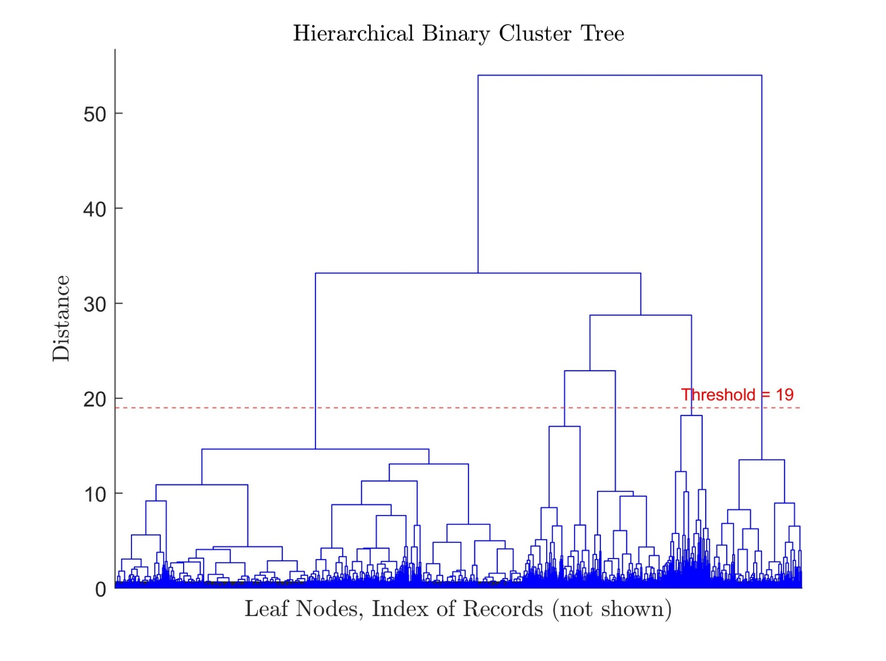
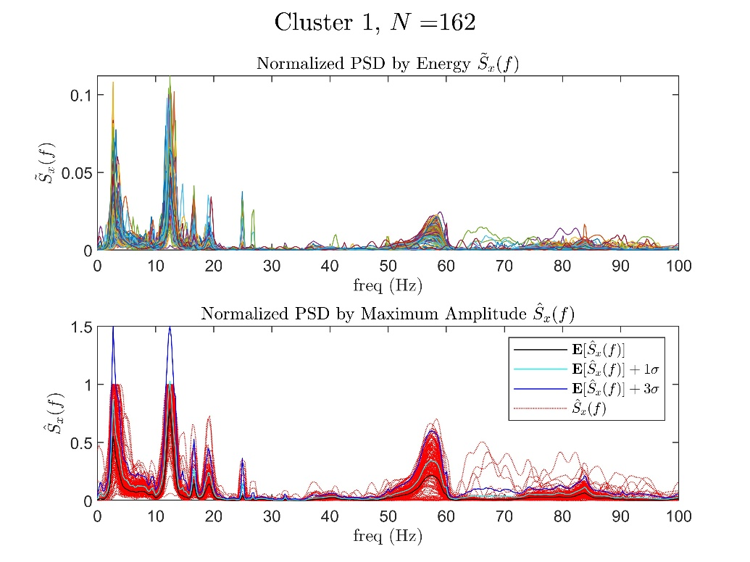
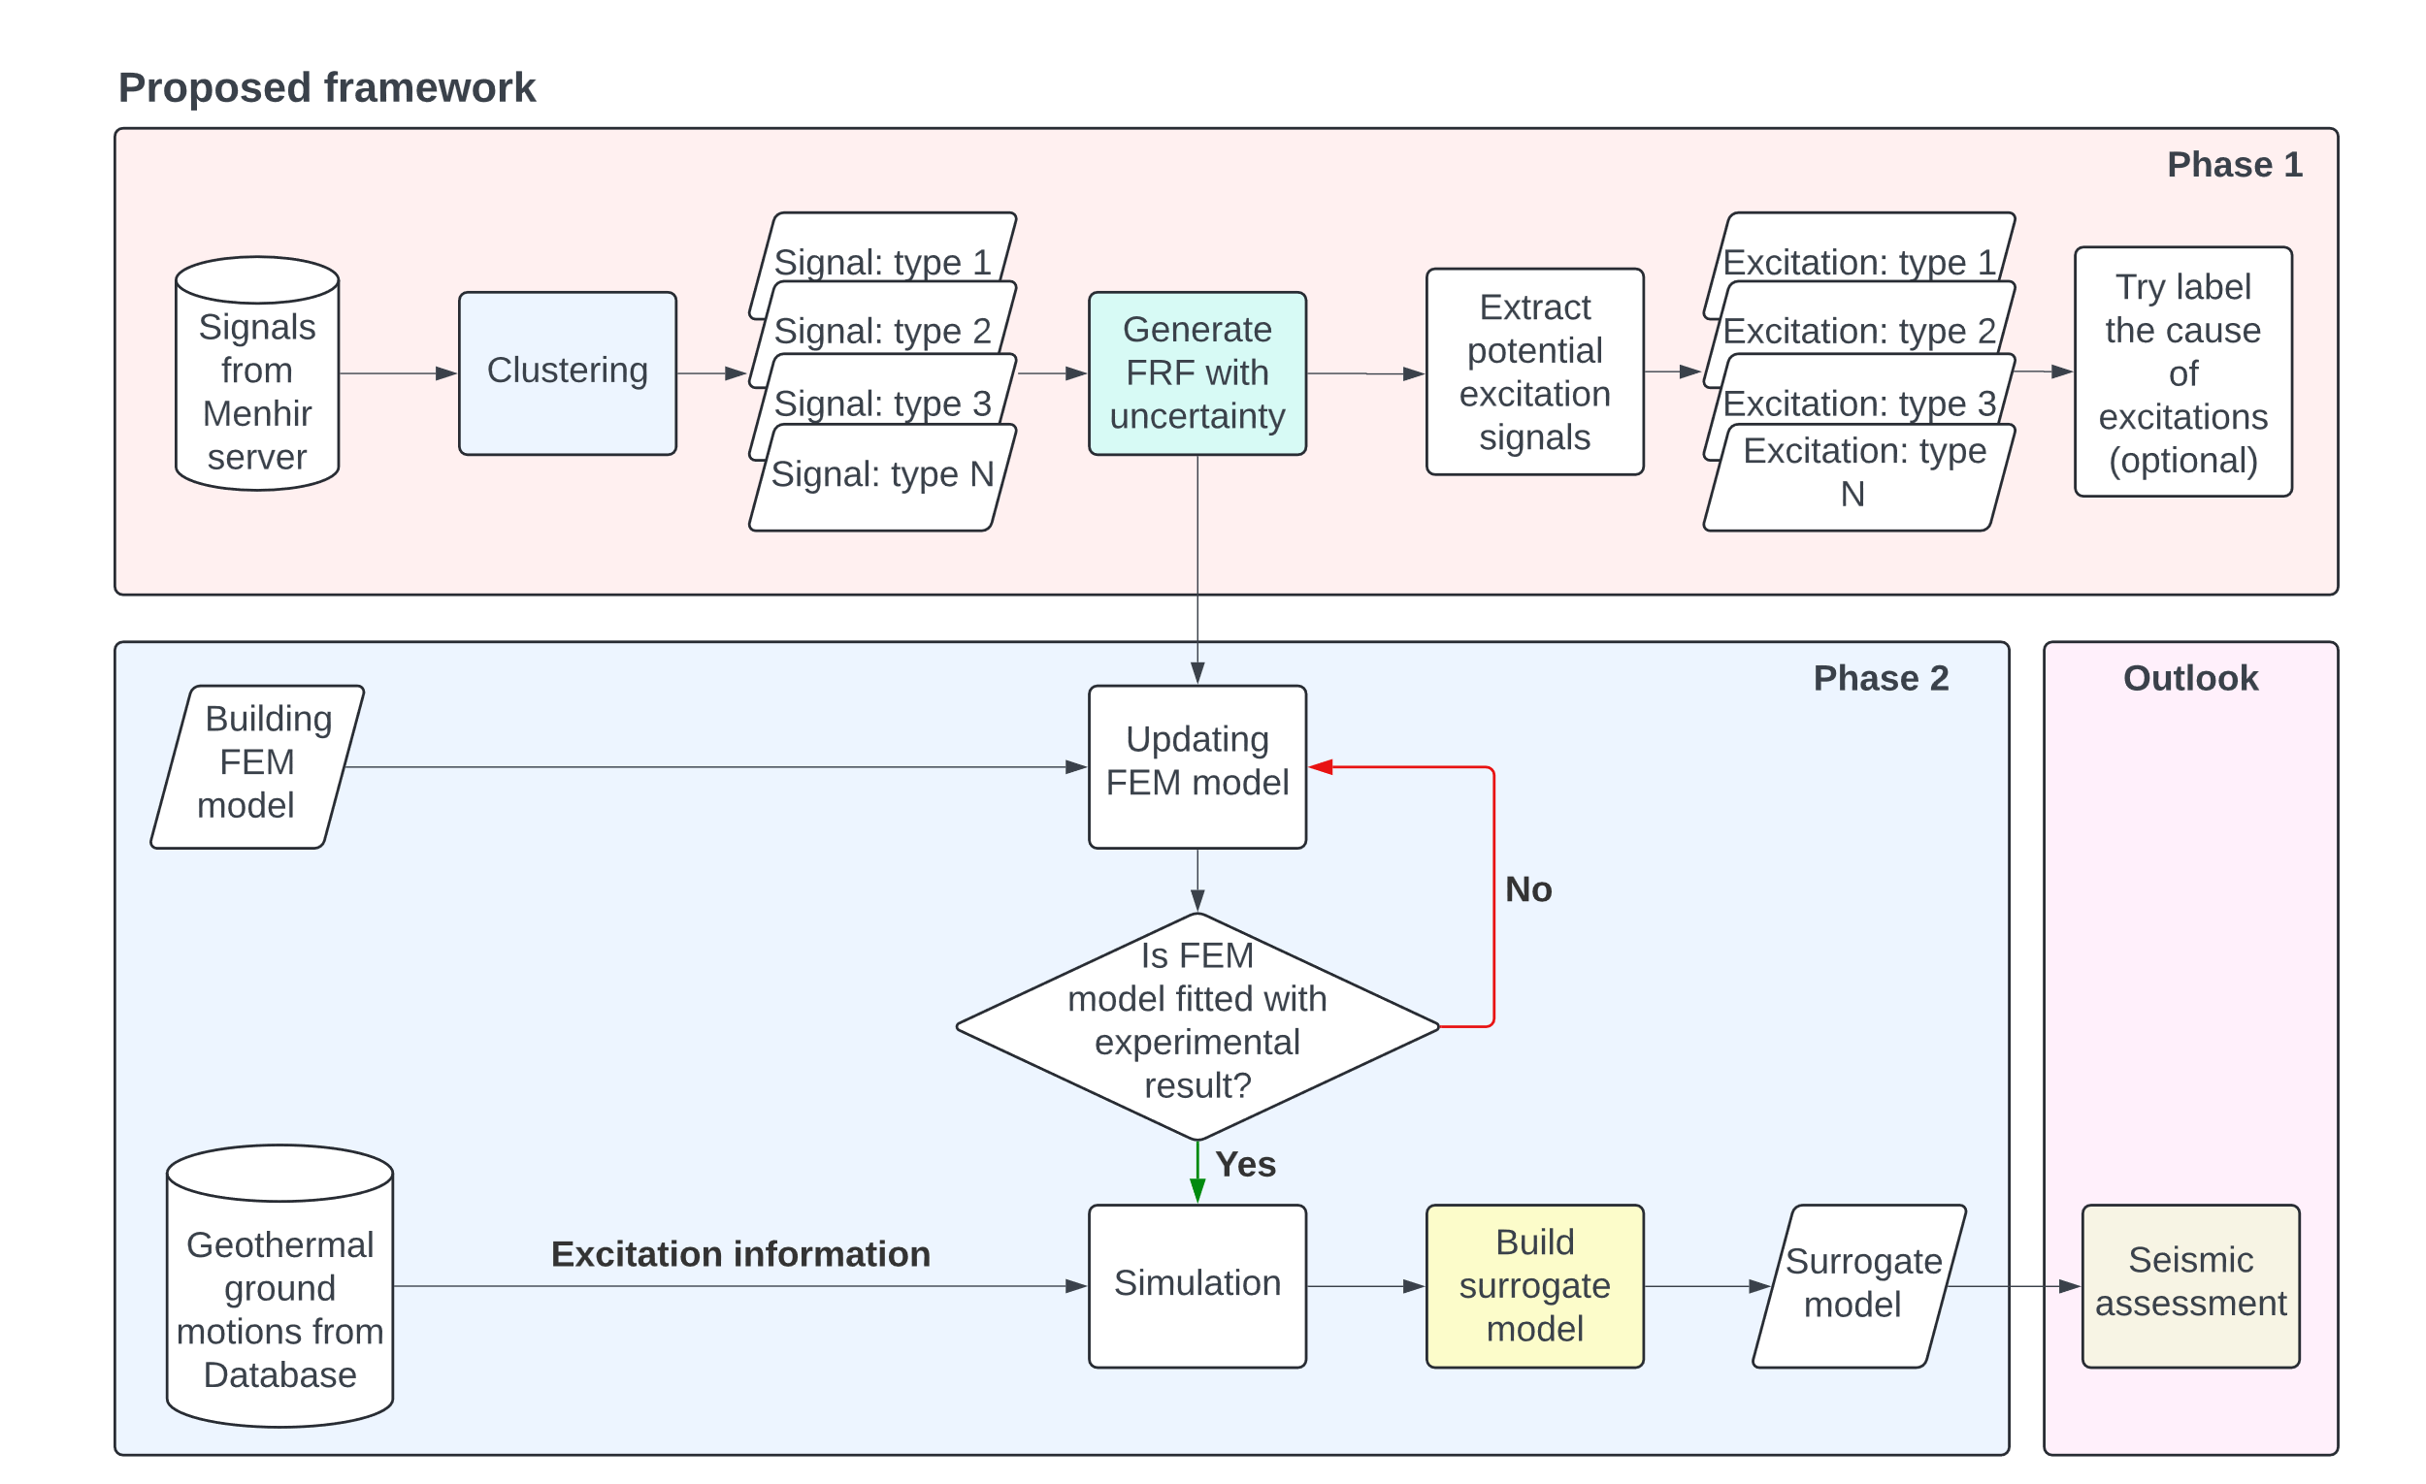
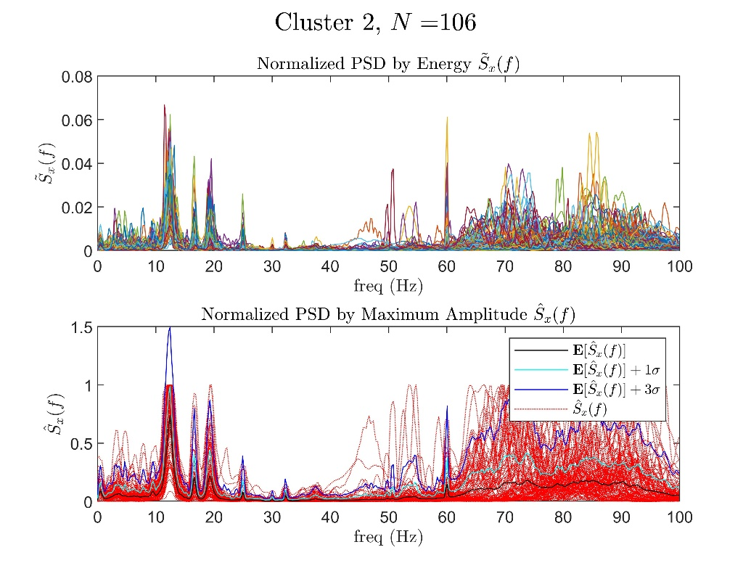
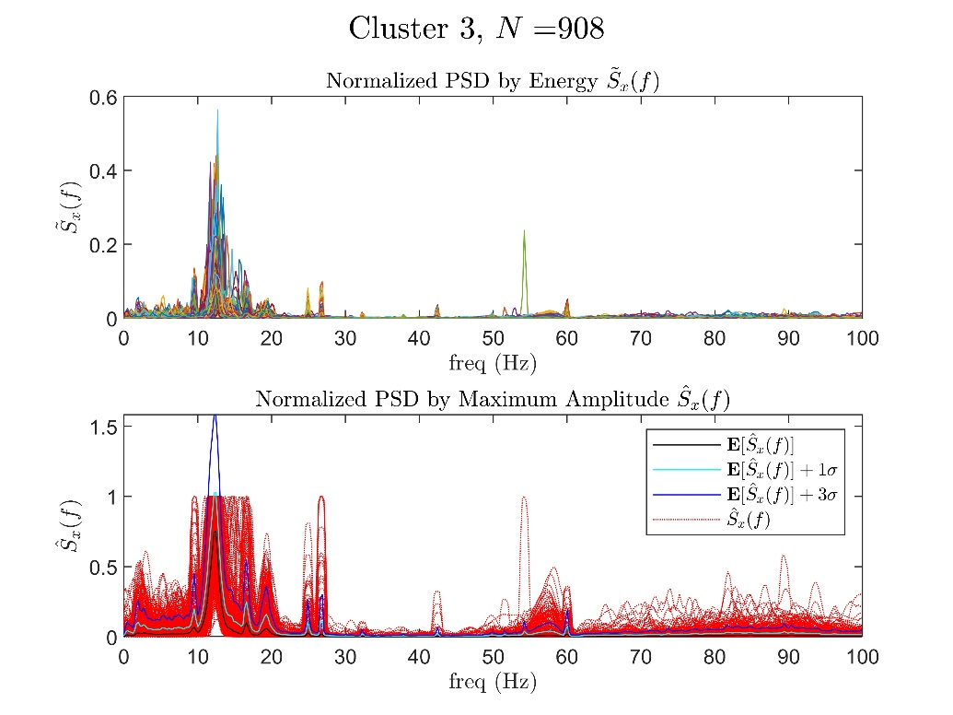
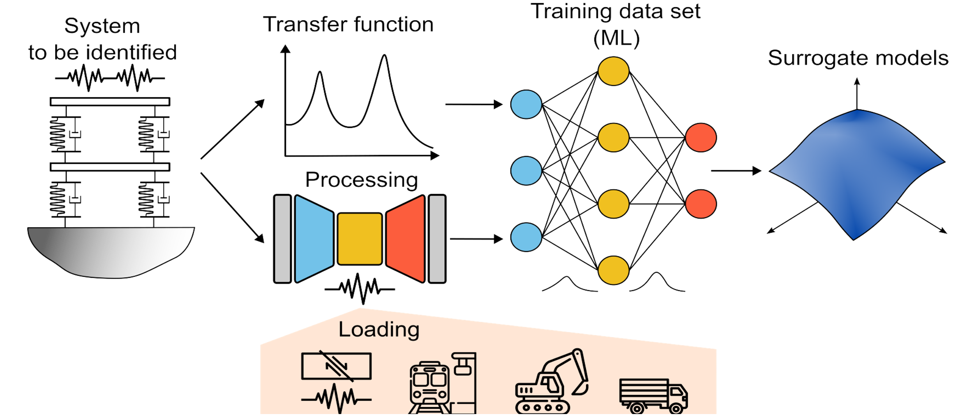
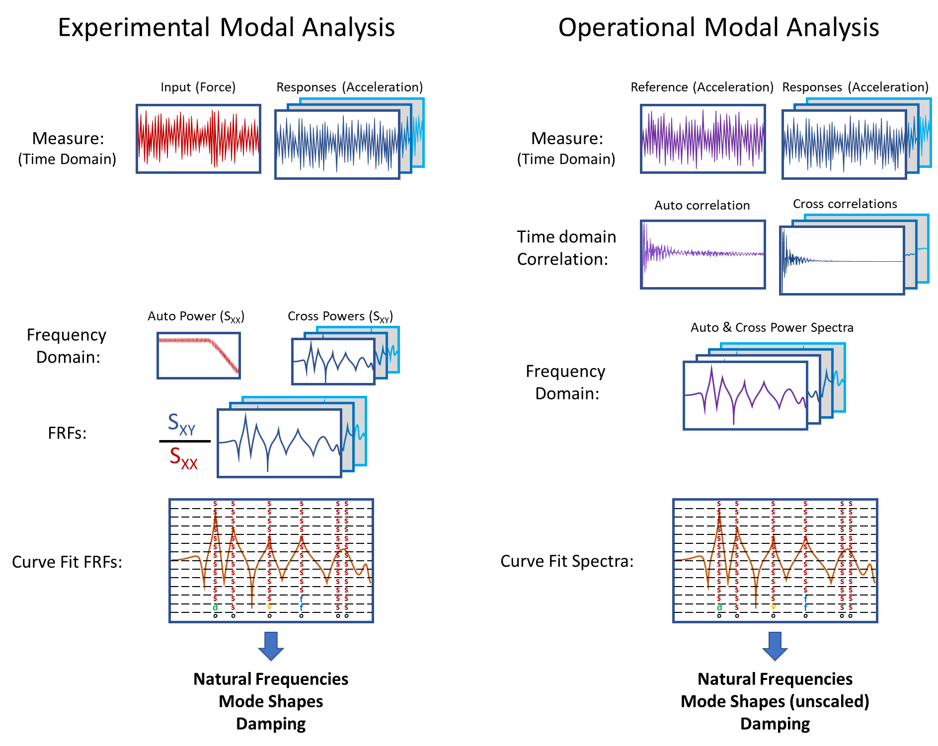




Enhancing Seismic Safety in Munich's Geothermal Energy Sector: Data-driven Model Updating for Building Vibrations under Induced Seismicity
Wei-Teng Kao, Aditi Kumawat
Prof. Dr. Gerhard Müller (Chair of Structural Mechanics), Prof. Dr. Wolfgang Wall (Chair of Numerical Mechanics)
Abstract
With increasing concerns about non-renewable resources, geothermal energy is becoming increasingly important for heat and power generation. Germany has set a goal to obtain a significant share of its energy from renewable sources by 2050. Deep geothermal power plants (GPP) are expected to make a significant contribution to meeting the energy demands. However, these GPPs cause micro-seismic events that affect the serviceability of buildings and human comfort [1]. Until now, the measurement of seismic activity in the Bavaria region relied on the free-field vibration sensor network. Recently additional sensors were installed on different levels of a low-rise building on the site of a GPP in the south of Munich. This strategic sensor placement aims to collect and analyze unique vibration data. The project focuses on improving the understanding and prediction of building responses to micro-earthquakes through data-driven model updating.
The project will be completed in two phases. The first phase will involve processing and preparing existing sensor data using classical and modern machine learning approaches, such as unsupervised learning, for automatic data processing and feature extraction. The second phase will involve developing surrogate models to quantify uncertainty and replace detailed nonlinear analyses. These models will use experimental data to improve the prediction accuracy of structural behavior under induced seismicity. This project aims to enhance existing building models with experimental data to create a predictive model for mitigating the effects of induced seismicity in geothermal plants. By monitoring building integrity under induced seismicity, the project will contribute to the safety and efficiency of geothermal operations in Munich and potentially world (fig 1).
Overall Framework
To understand and predict the effect of microquakes on buildings, the following framework is proposed (fig 2), which includes two stages. For this project, two databases are accessed; the first stores the sensor data from monitoring the vibration signals in the example building for over one year, and the second saves weak to moderated scaled geothermal-induced seismicity from seismic stations in Insheim, Germany.
Phase 1
In the first phase, The focus is on extracting the frequency response function (FRF) or so-called transfer function (TF) and identifying the system of example building by analyzing the existing sensor data. The uncertainty of FRF will be quantified to better describe the building model. This process includes the following steps:
Clustering: Since the sensor data are unlabeled and the source of excitation is unknown, the clustering technique is utilized to characterize different response types based on signal pattern in the frequency domain. By analyzing each clustering, the outlier and the responses severely compromised by noise could be discarded early on (fig 3).
Identifying the system: The system of the building is commonly represented by the natural frequency, damping ratio, and the mode shapes of a structure. These parameters are significant for verifying accuracy and calibrating a finite element (FE) model. Practically, the building system can be identified using experimental modal analysis (EMA) or operational modal analysis (OMA) [2]. The difference between EMA and OMA is that EMA analyzes the system via measured force during the experiment, such as hammer impact and shaker. Conversely, OMA determines the system from operational vibration measurements, especially under real-world operational conditions (fig 4).
Forming the FRFs: FRFs represent the response of a system per unit excitation as a function of frequency. The experimental FRFs of the building can be extracted by measurement tests, such as impact and shaker testing (fig 5). To parameterize the FRFs, the rational fraction polynomial method (RFP) or the mode superposition method (MSUP) could be applied, which are based on classical or modern curve fitting procedures.
Fig 3, Clustering the recorded sensor data using the hierarchical clustering (HC) technique.
Fig 2, The proposed framework of the whole project
Fig 1, Schematic diagram showing the project outline. By monitoring the vibration of the example building, the system of the building and the potential loading types can be identified. The behavior of such structure dynamics will be trained and predicted by the surrogate model built via the machine learning technique.
Fig 4, Comparison of two system identification techniques, EMA and OMA [3].
.
M.Sc. Wei-Teng Kao
TUM Chair of Structural Mechanic
Technical University of Munich Arcisstr. 21 80333 Munich
ge32gak@mytum.de
Dr. Aditi Kumawat
TUM Chair of Structural Mechanic
Technical University of Munich Arcisstr. 21 80333 Munich
aditi.kumawat@tum.de
Prof. Dr. Gerhard Müller
TUM Chair of Structural Mechanic
Technical University of Munich Arcisstr. 21 80333 Munich
gerhard.mueller@tum.de
Prof. Dr. Wolfgang Wall
TUM of Numerical Mechanics
Technical University of Munich
Boltzmannstr. 15 85748 Garching b.
wolfgang.a.wall@tum.de
MDSI General Assembly, October 24, 2024

Slide 2
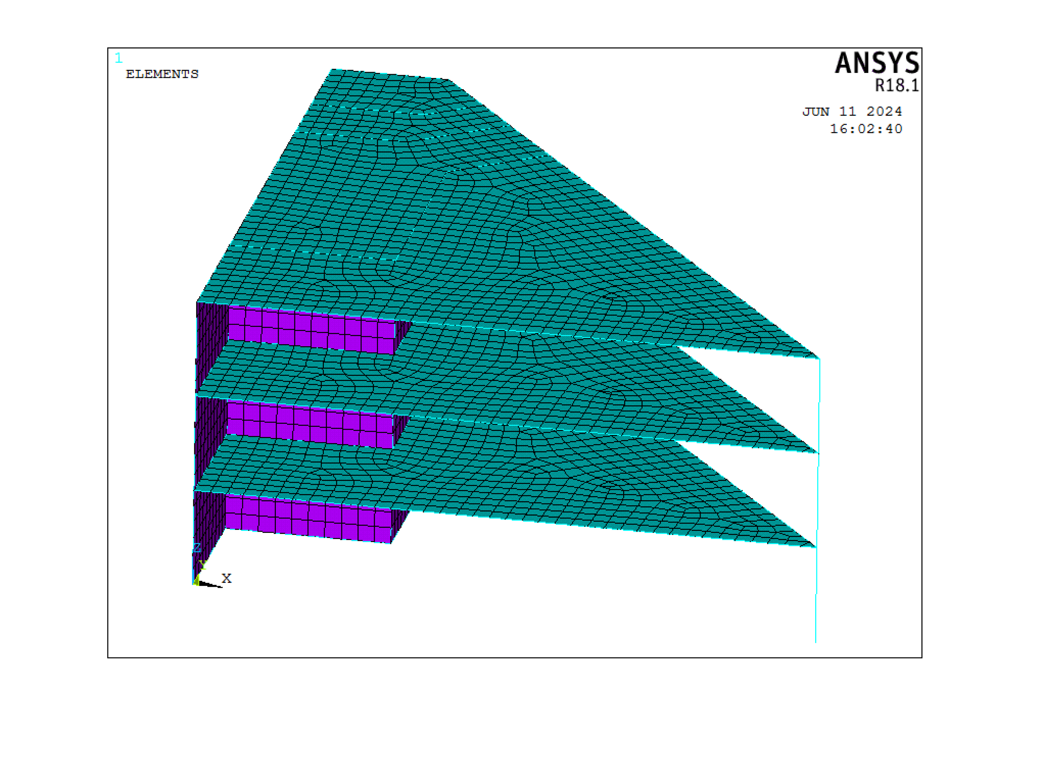
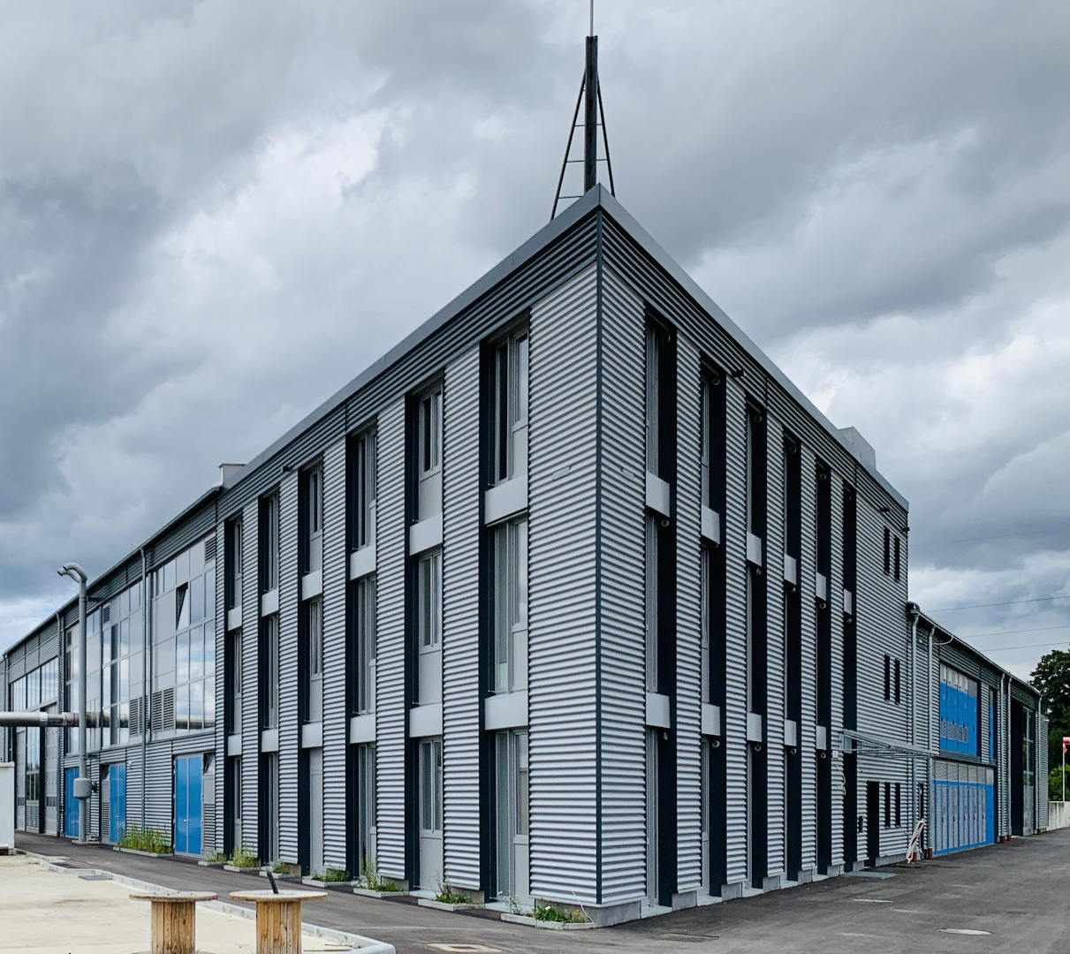
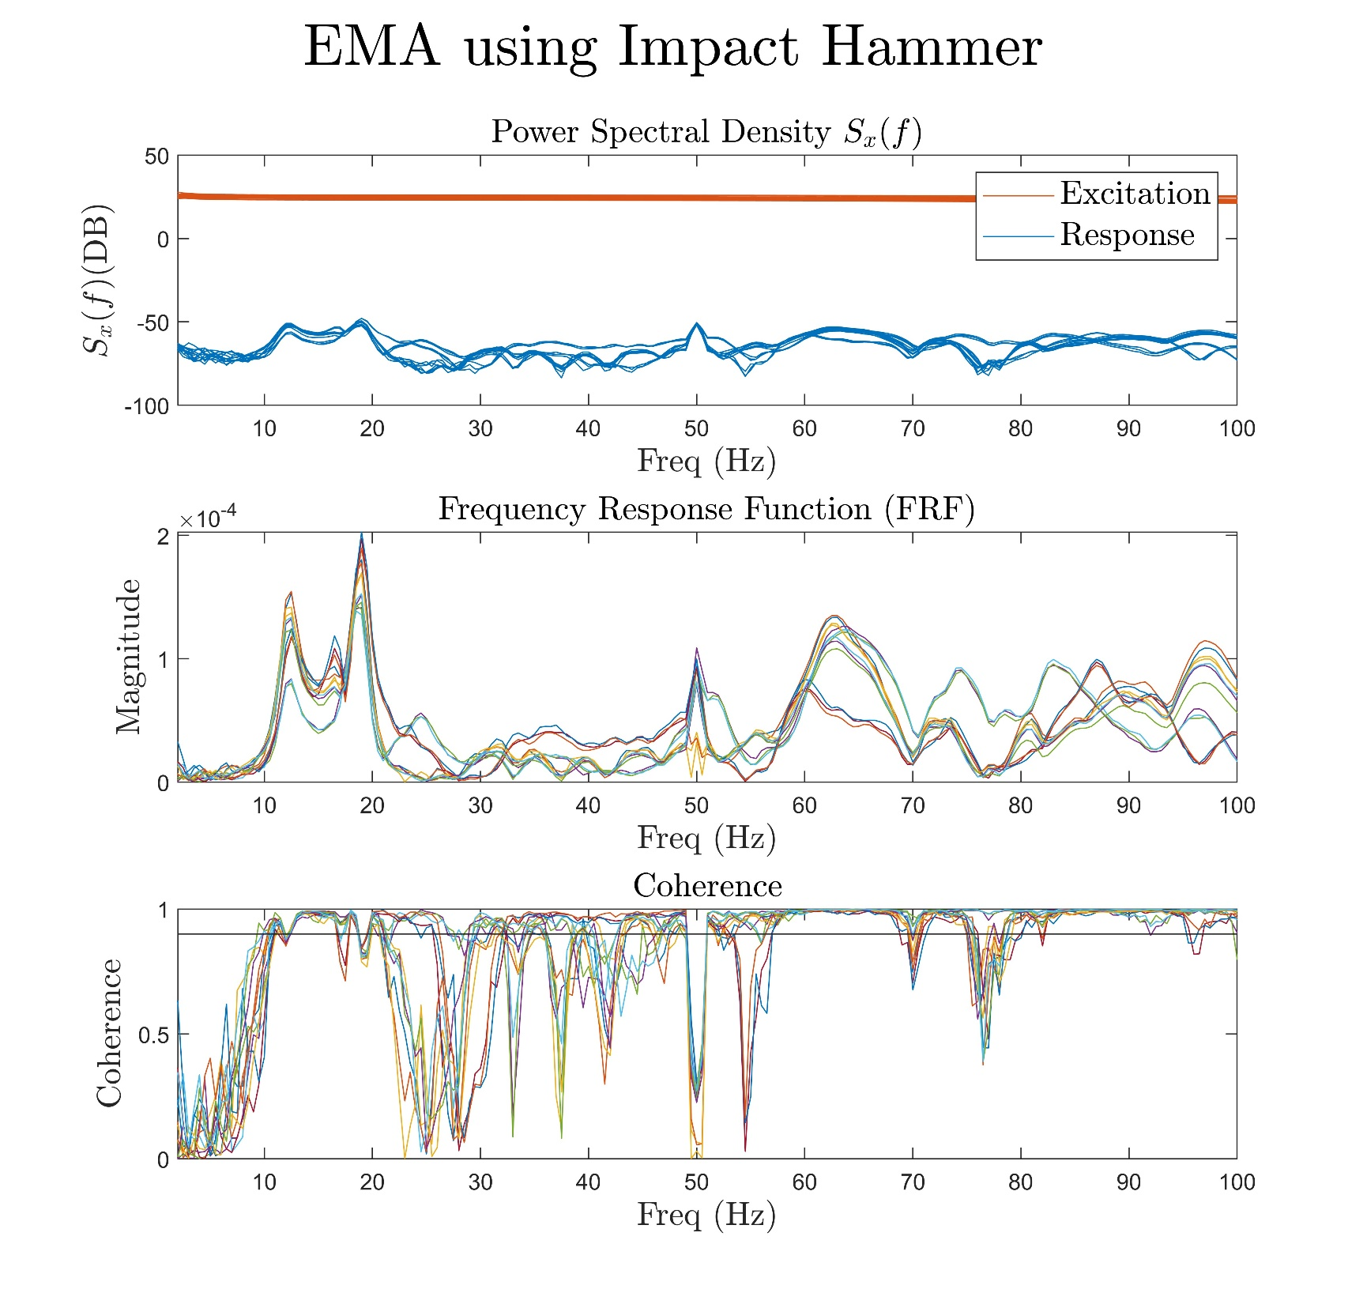
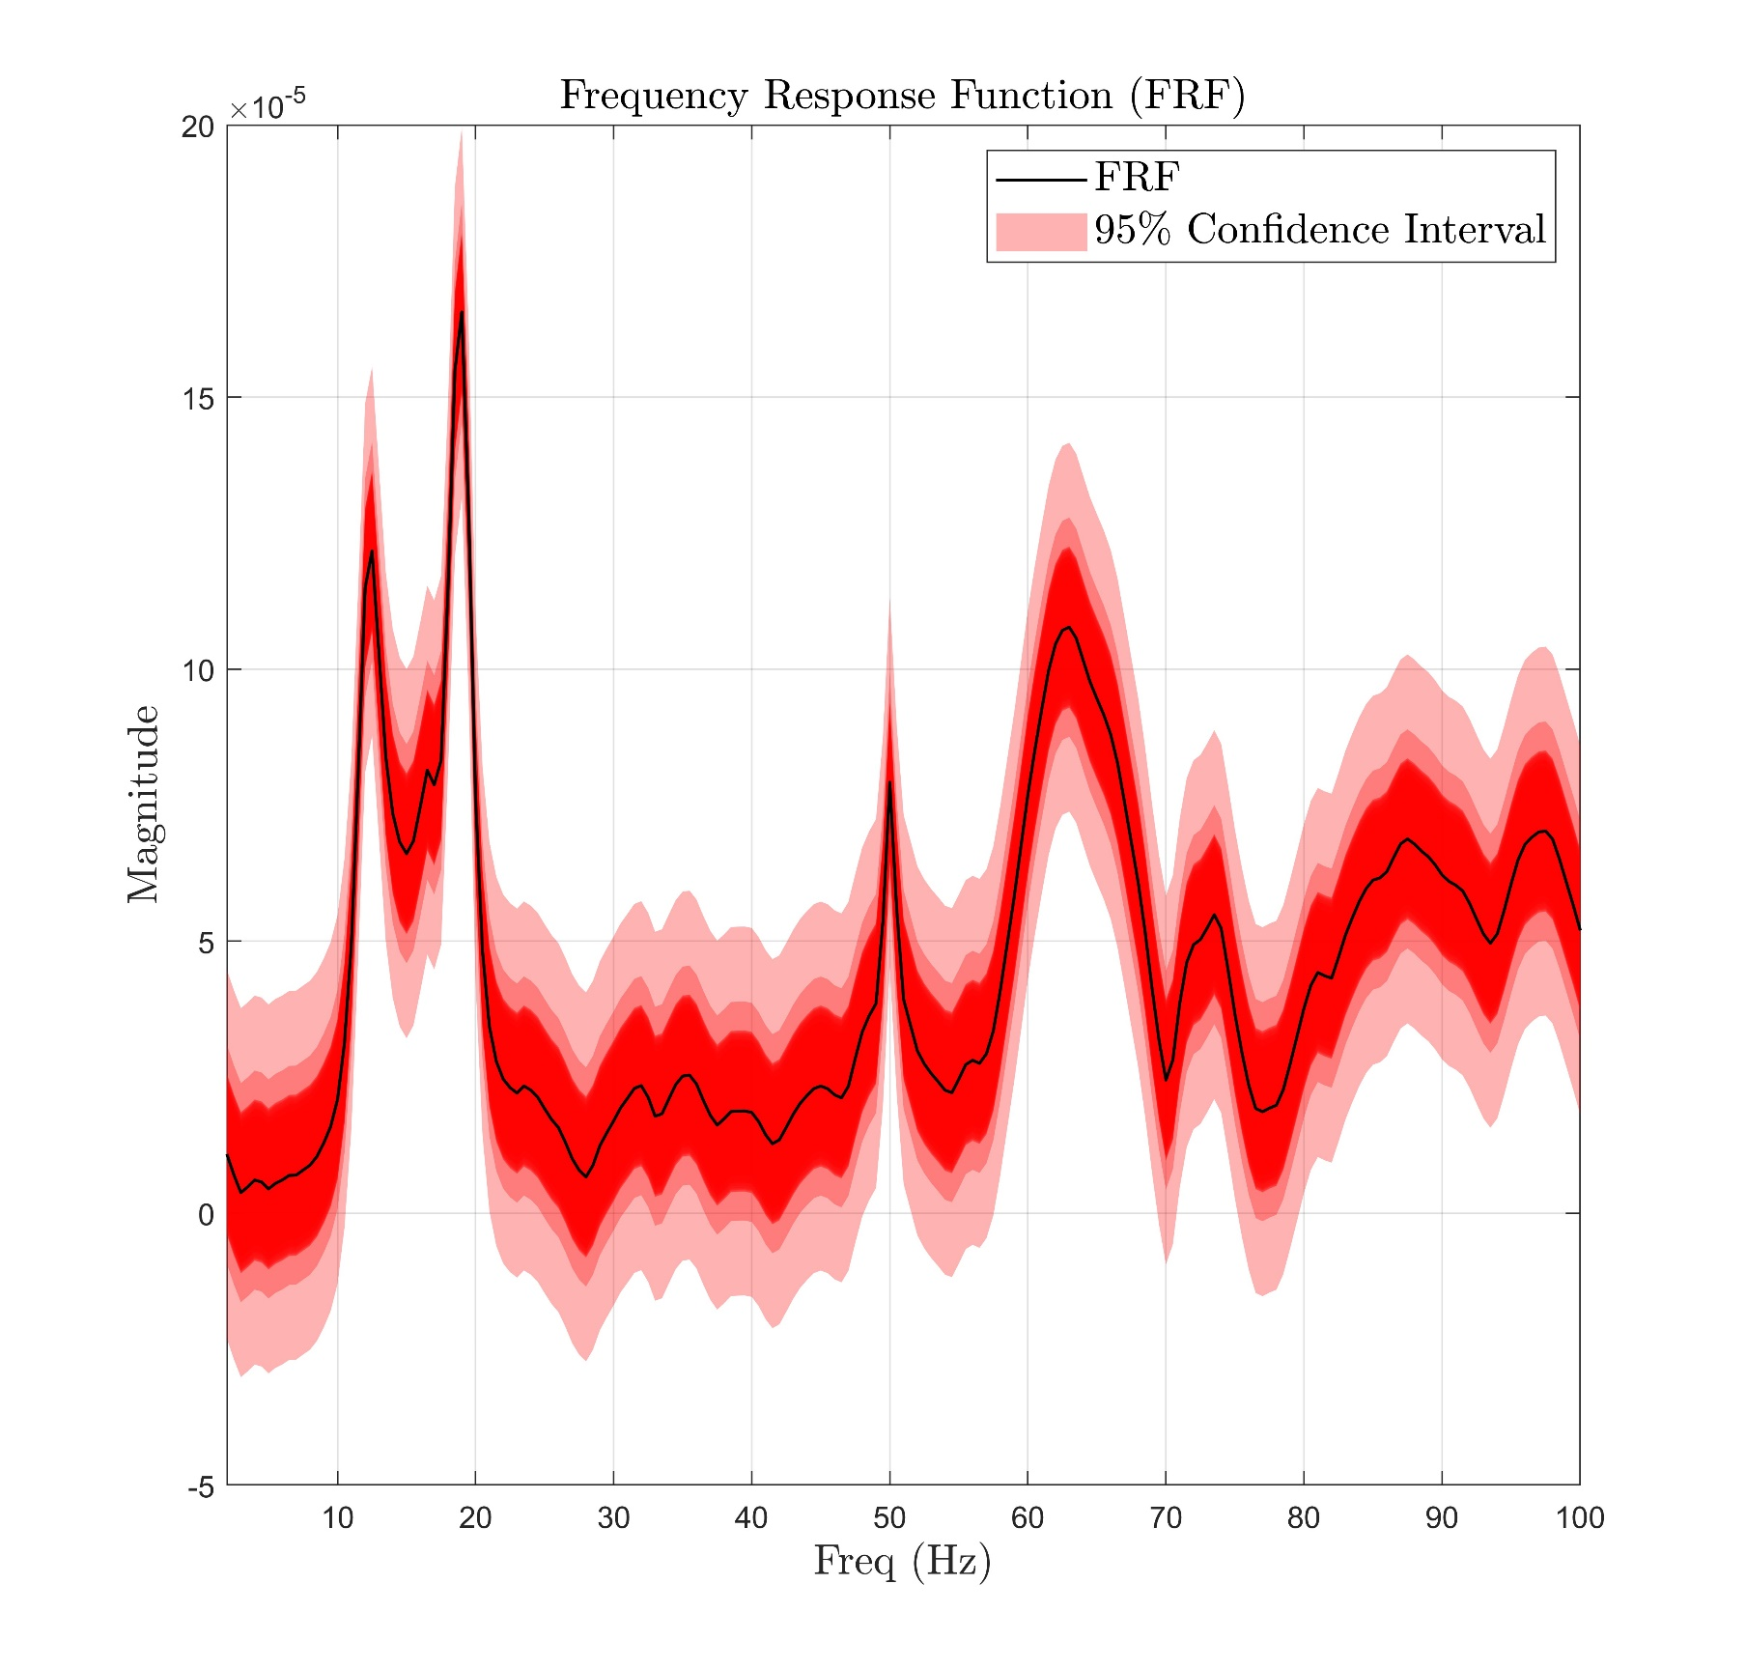
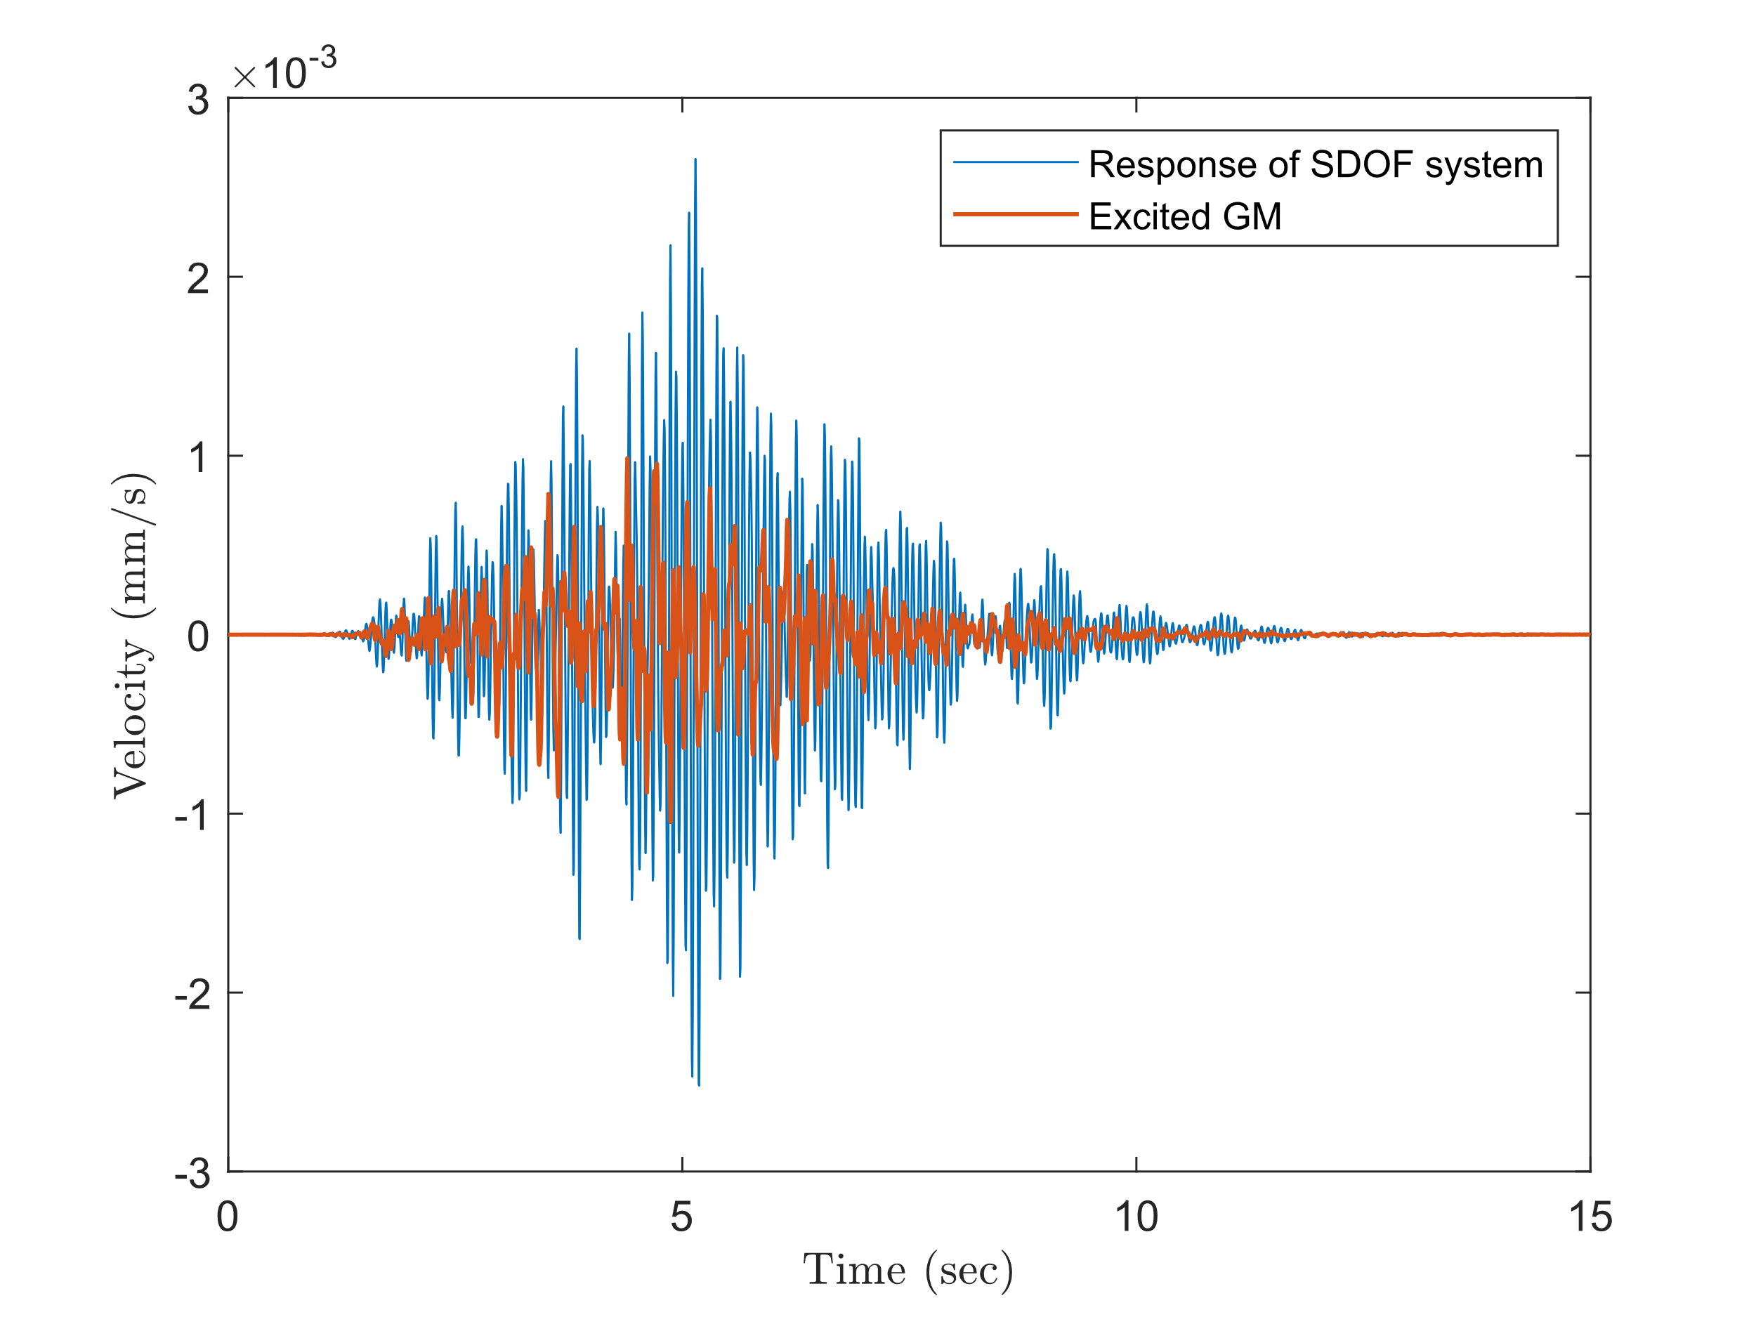
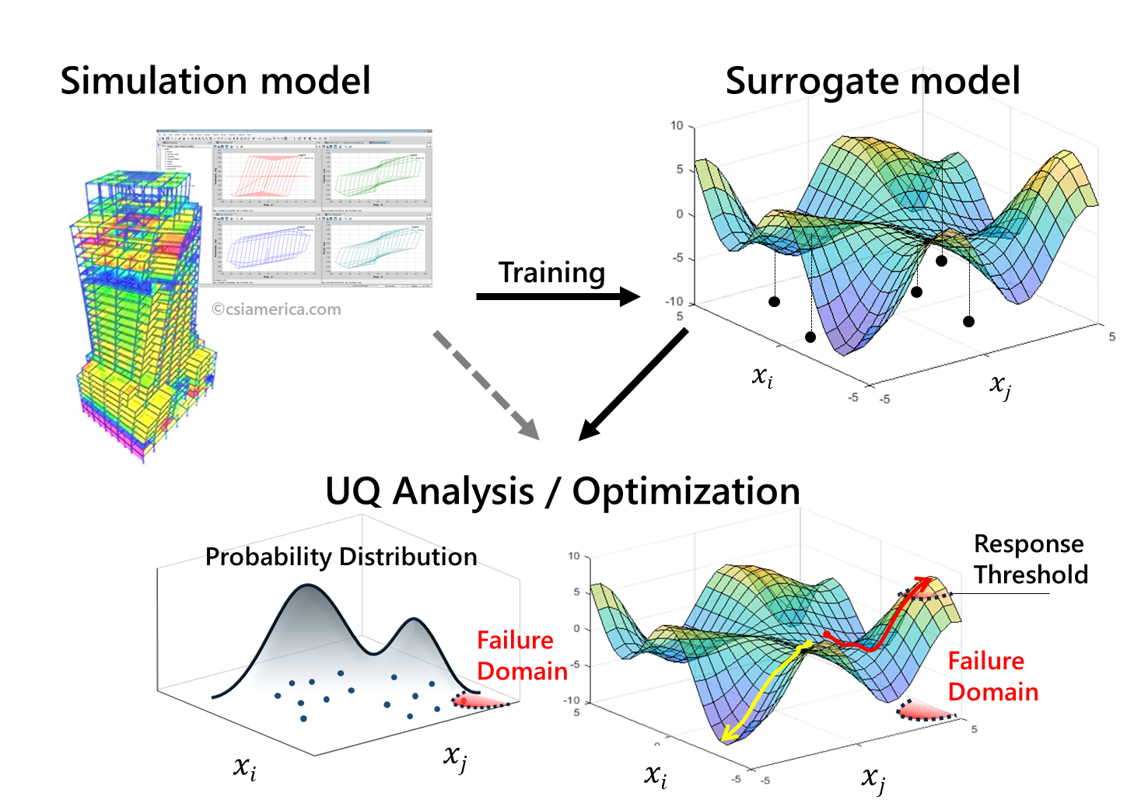

Enhancing Seismic Safety in Munich's Geothermal Energy Sector: Data-driven Model Updating for Building Vibrations under Induced Seismicity
Wei-Teng Kao, Aditi Kumawat
Prof. Dr. Gerhard Müller (Chair of Structural Mechanics), Prof. Dr. Wolfgang Wall (Chair of Numerical Mechanics)
Infer the possible excitations: Once the FRFs are formed and the predominant natural frequency and damping ratio are identified, the possible excitation causing the vibration of the building from the first database will be inferred. When combined with insights from the prior clustering process, this will provide a deeper understanding of the environment and the building's characteristics, such as the impact of different excitation types on the structure and the behavior of responses across various frequency ranges.
Phase 2
The surrogate model is a model that can efficiently interpret the relationship between input and output behavior of complex systems. The surrogate model will be developed after the training data from Phase 1 are prepared. The following steps will accomplish this stage:
Building the FE model: The finite element (FE) model transfers the real-world complex structure to the computational solvable model. By defining the geometry of the building and the material properties of the structure, the mathematical building model (fig 6) will be built and ready for further analysis.
Updating the FE model: The results of FE models are commonly deterministic and depend on the parameters defined by the user. This implies that if the user provides inappropriate parameters for the model, then the following simulation might lead to inaccurate results. To overcome this issue and improve the accuracy of the result, the parameters of the FE model are updated and validated by the system information identified in the first phase. This process is crucial to generate a representative FE model for acceptable results from simulation.
Simulation: To understand the influence of geothermal-induced earthquakes on the example building, the structure dynamic is simulated by transient or harmonic analysis using the commercial software Ansys. The input loadings considered in this project are the vibration signals of geothermal-induced earthquakes recorded from seismic stations. The results will provide information on the building’s deformation, velocity, or any requested physical information under such excitation (fig 6).
Building the surrogate model: Simulation via FEM is time-consuming and computationally expensive. Some high-fidelity time-dependent simulations might take over 8 hours for only one event. To fulfill the goals of this project, which might require evaluating more than 1000 events, the techniques to accelerate or replace the costly simulation are necessary. Building a probability-based surrogate model helps us efficiently re-construct the relationship between input parameters and output results and considers the uncertainty (fig 7). This surrogate model can be built using advanced regression methods or machine learning techniques, such as neural networks (NN).
Outlook
This seed-fund project aims to construct an efficient model to represent the example building by combining existing sensor data, computational mechanics, and modern machine-learning techniques. This model could be used for further analysis, such as:
Global sensitivity analysis (GSA): The GSA provides information about the significance of each designed parameter. With this technique, researchers can better understand which parameter of the building might have caused the largest impact on the structure under earthquakes.
Serviceability analysis: This assessment analyzes a structure’s ability to remain functional for its occupants during normal usage without exceeding certain limits on factors like deflection, vibration, and cracking.
Comfortability analysis: Comfortability analysis for buildings evaluates the influence of the vibration levels on the comfort of the occupants within the built environment.
References
FE Model
Update model
https://www.tiefegeothermie.de/news/ertuechtigung-der-geothermiebohrungen-taufkirchen
Simulation
Fig 6, Building the FE model and performing the simulation to understand the structure dynamics of the example building under excitation [4].
Fig 5, FRFs obtained by hammer testing using the EMA technique, N = 13 (left), and the mean FRF with the 95% confidence range (right)
Fig 7, Schematic diagram of building surrogate model. With the help of the surrogate model, one can compute the representative result for the problem without time-consuming FE simulation and accelerate the process of further risk assessment [5] .
[1] Küperkoch, L ; Olbert, K ; Meier, T: Long-term monitoring of induced seismicity at the Insheim geothermal site, Germany. In: Bulletin of the Seismological Society of America 108 (2018), Nr. 6, p. 3668–3683.
[2] Orlowitz, E., & Brandt, A. (2017). Comparison of experimental and operational modal analysis on a laboratory test plate. Measurement, 102, 121-130.
[3] MacDonald, S. (10 July 2020). OMG! What is OMA? Operational Modal Analysis. SIEMENS community. https://community.sw.siemens.com/s/article/OMG-What-is-OMA-Operating-Modal-Analysis
[4] Kao, W.T. (2024). Integrated Parameter Study and Serviceability Assessment of Building Structures under Geothermally Induced Seismicity using Stochastic Polynomial Chaos Expansion [Unpublished master's thesis]. Technical University of Munich.
[5] Zou, J., Welch, D. P., Zsarnoczay, A., Taflanidis, A., & Deierlein, G. G. (2020). Surrogate Modeling for the Seismic Response Estimation of Residential Wood Frame Structures.
M.Sc. Wei-Teng Kao
TUM Chair of Structural Mechanic
Technical University of Munich Arcisstr. 21 80333 Munich
ge32gak@mytum.de
Dr. Aditi Kumawat
TUM Chair of Structural Mechanic
Technical University of Munich Arcisstr. 21 80333 Munich
aditi.kumawat@tum.de
Prof. Dr. Gerhard Müller
TUM Chair of Structural Mechanic
Technical University of Munich Arcisstr. 21 80333 Munich
gerhard.mueller@tum.de
Prof. Dr. Wolfgang Wall
TUM of Numerical Mechanics
Technical University of Munich
Boltzmannstr. 15 85748 Garching b.
wolfgang.a.wall@tum.de
MDSI General Assembly, October 24, 2024

